Slide 1
Neural FCA On Income Dataset
Muhammad Asad

Slide 2
Dataset
The goal is to predict whether an individual earns more than $50K based on various demographic and employment-related feature

Slide 3
Dataset Description
Age: Age of the individual.
Workclass: Employment sector of the individual.
Fnlwgt: Final weight representing the number of people in the population that the sample represents.
Education: Education level attained by the individual.
Educational-num: Numeric representation of the education level.
Marital-status: Marital status of the individual.
Occupation: Type of work performed by the individual.
Relationship: Family relationship role.

Slide 4
Race: Race of the individual.
Gender: Gender of the individual.
Capital-gain: Income from investment sources (excluding salary).
Capital-loss: Loss from investment sources.
Hours-per-week: Number of hours worked per week.
Native-country: Country of origin.
Income: Income class ($50K or less, $50K or more). Y variable

Slide 5
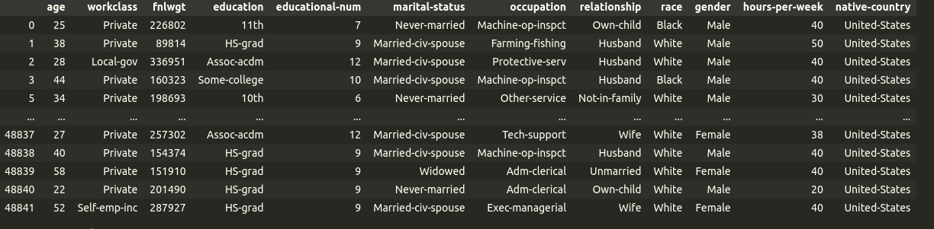

Slide 6
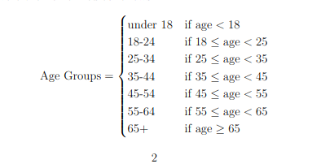
Binarization
Age Group Ordinal

Slide 7
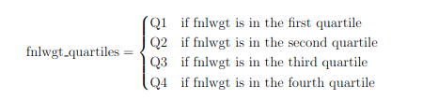
Work Class and Final weight Column
Having 7 unique value in workclass column.
Apply Nominal Scale
Creating binary variables for each unique category in the workclass column.
Created Nominal Scaling for work class
Created Interordinal Scaling for Final Weight Column

Slide 8
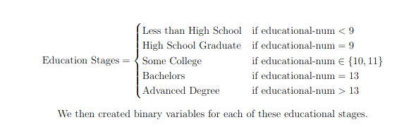
Education Level and Education Number Binarization
Having 16 unique values in Education Level so did nominal scaling for education level
Each column indicates whether an individual holds a specific education level
Ordinal Scale for educational Stages

Slide 9
Marital Status , Occupation And Relationship Column
(Nominal)
Marital Status having 7 unique value
Created a binary column for each marital status category
Same goes for Occupation, having 14 unique occupations in the data which is categorical
Created a binary variable for each occupation category
The relationship Column have 6 unique values
Binarized by creating a binary variable for each unique relationship status

Slide 10
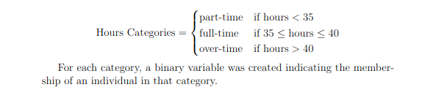
Race, Gender and Hours Worked per Week Column
Race Column have 5 unique value so binarized by nominal scale
Gender have 2 unique values in dataset so binarized by Dichotomous
The feature hours-per-week was categorized into three groups based on work hours applying ordinal scale

Slide 11
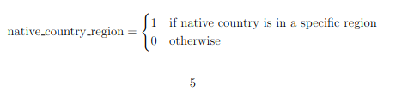
Native Country Column
For the native-country feature, we first grouped countries into regions
Native Country have 41 unique values
Created Region for each Country
Applying Nominal Scale

Slide 12
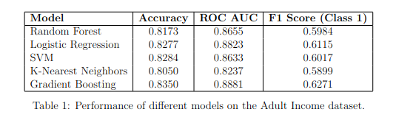
Results on Different Classification models

Slide 13
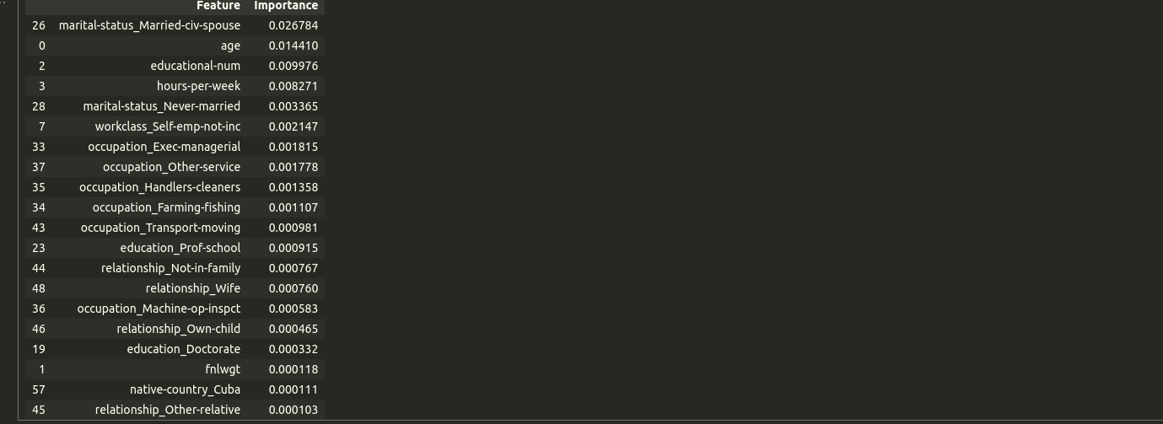
Feature Importance for Standard Models

Slide 14
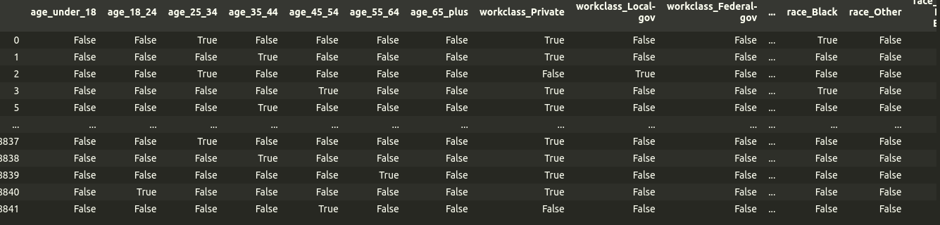
Neural FCA

Slide 15
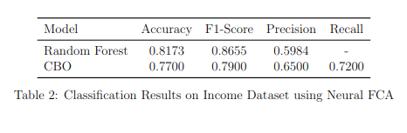

Slide 16
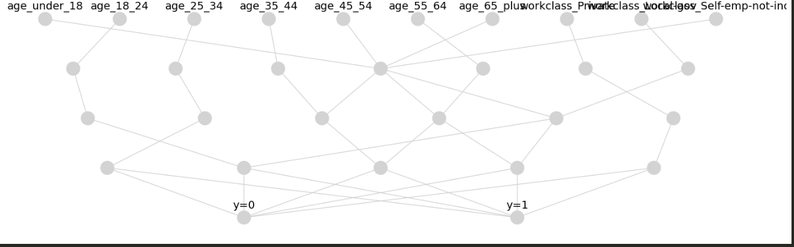
Neural FCA

Slide 17
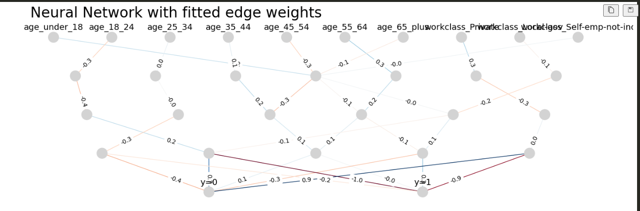

Slide 18
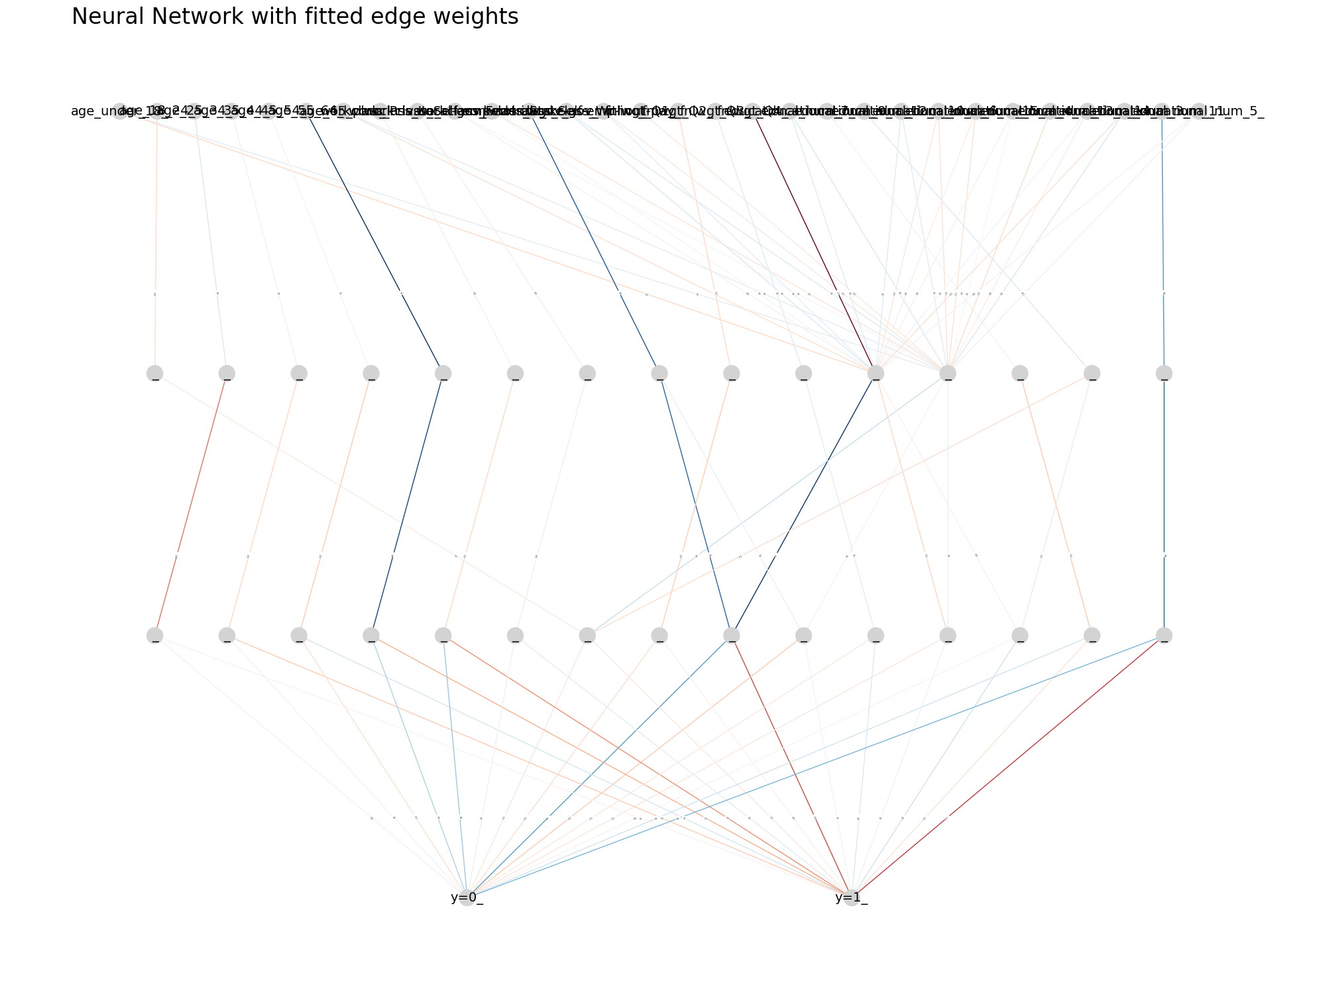

Slide 19
Visualization: This lattice can be visualized to show the relationships between different concepts learned by the neural network, making the model's reasoning more transparent.
Reasoning:
By reading the network from top to bottom, you can form a narrative about the model’s reasoning:
Which input features (like “age_35_44” or “workclass_Private”) strongly influence the hidden nodes?
How do those hidden nodes combine and interact to reinforce or counteract each other?
Which sets of intermediate concepts correlate strongly with the final classification?

Slide 20
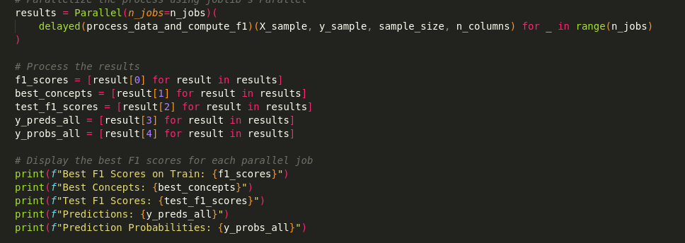
Improvements on Faster Calculation

